Slide 1
Zmanda Overview
Enterprise Backup and Recovery

Slide 2
Executive Summary
ZMANDA ENTERPRISE BACKUP AND RECOVERY
Financial
Total cost of ownership: 50%-80% lower TCO compared to the competition.
Reduced administrative cost: Prepackaged for 15-minute deployments. Achieve 3-2-1 in 2 clicks with Zmanda Cloud Storage.
Proven and reliable: Founded in 1991. #1 open source EBR. Included with all enterprise Linux distros. 1M+ servers protected.
Technical
Full-featured & comprehensive: Backup workloads across hybrid-cloud data centers to local disk, tape, and all major cloud providers.
Ransomware protection: Integrated support for immutable storage, air gap, and disaster recovery. Security features including BYOK, LDAP, SSO, and RBAC.
High performance: Petabyte scale. Cluster architecture. Qualified at 400 parallel backups per instance with 15GB/s throughput.
Lifecycle Support
Support from Industry Experts: 24*7 onboarding and technical support. 2X industry average NPS.
Dedicated Account Team: Account Manager and Sales Engineer for triage, right-sizing, and technical guidance.
Self-Service and Pro Services: Comprehensive documentation, knowledge base, technical videos, and certification tracks. Pro Services for custom engagements.

Slide 3
World’s biggest brands trust Zmanda
OUR CUSTOMERS

Slide 4
#1 open-source backup and recovery solution
ZMANDA BACKGROUND
Amanda
Zmanda
Amanda Community Edition | Since 1991
Amanda Enterprise Edition | Since 2005
Development started at the University of Maryland with BSD license.
Amanda is packaged in all major Enterprise Linux distributions.
Support for virtualized and hybrid cloud environments
Built on Amanda Community Edition

Slide 5
Proven product that delivers 80% TCO savings
WHY ZMANDA
Proven, reliable, scalable backup & recovery since 1991. The features you need at 80% less than the competition. Don’t pay by the gig.
Achieve offsite backup with ransomware protection in 2-clicks with Zmanda Managed Storage.
Open source based with open formats for no vendor lock in.
Tape/NAS backup and archive as core competency.
Support for all major public cloud storage providers.
Install in 15 minutes with prepackaged deployments.
Ransomware protection with immutable storage and air gap backups.
Zero-trust security, BYOK, LDAP, SSO, and RBAC.
OpenAPI V3 standard APIs for custom integrations.
24*7 support and professional services.

Slide 6
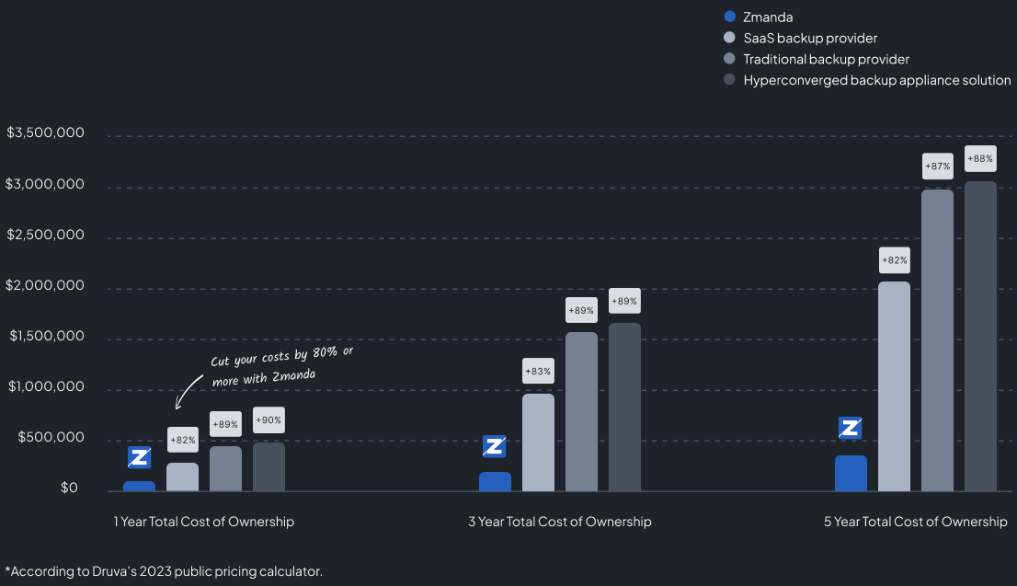
TCO compared to the competition
PRICING & TOTAL COST OF OWNERSHIP
Zmanda is licensed per workload.
Don’t pay by the gig.
Incredibly scalable, typically resulting in an 80% savings compared to our competitors.
Most cost-effective solution for 3-2-1 backup deployments and long-term data archival.

Slide 7
Harnessing the power of open source to transform your enterprise
OPEN-SOURCE
Features
Amanda Community
Amanda Enterprise (Zmanda)
Back up file systems in Windows and Linux
Back up to cloud, disk (NAS, SAN, ISCSI), and tape
Web-based centralized management console
User management – LDAP, RBAC
Data deduplication
SE Linux support
24/7 production support, professional services and training
See a detailed comparison at zmanda.com/amanda-enterprise

Slide 8
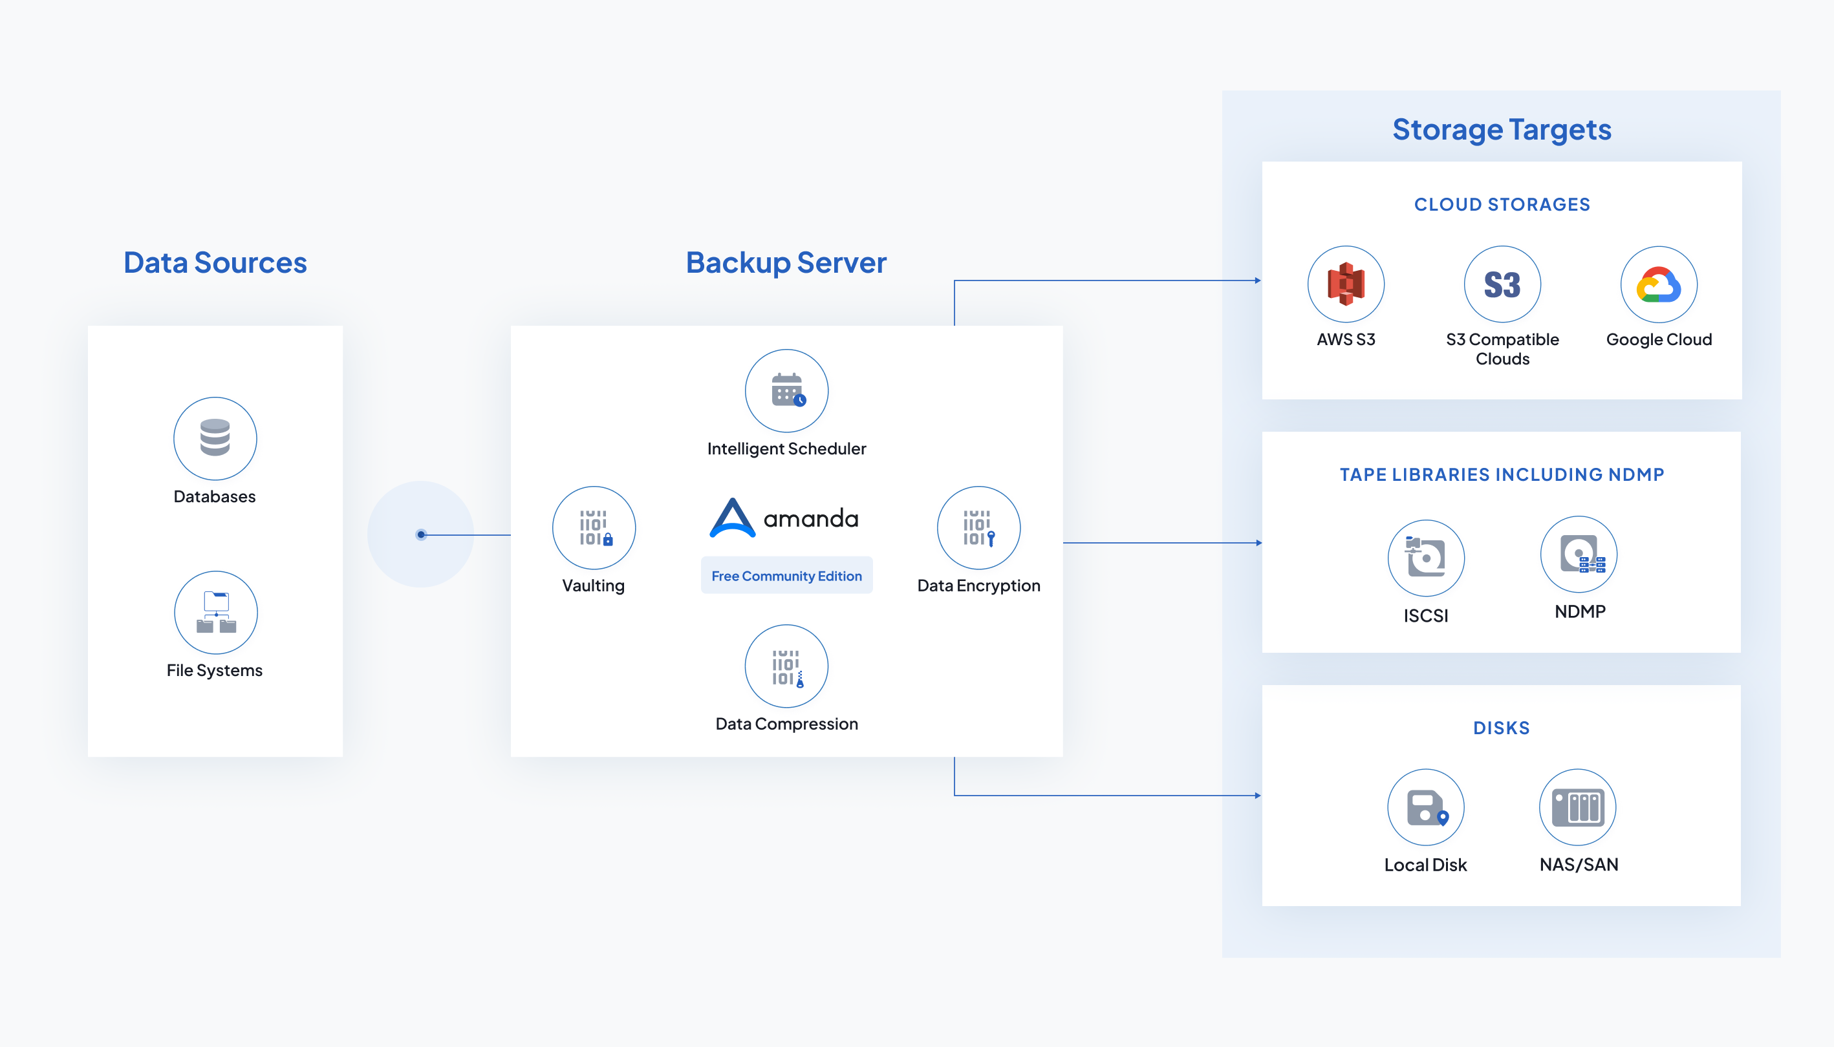
Harnessing the power of open source to transform your enterprise
OPEN SOURCE
Based on Amanda Community, an open-source project that started in 1991.
Zero-cost proof-of-concept. Integrate custom workflows and APIs.
Inspect the code, review the security model, and deploy in a zero-trust environment.
Open source based with open formats. No vendor lock in.
Free Open-Source Community Edition Capabilities

Slide 9
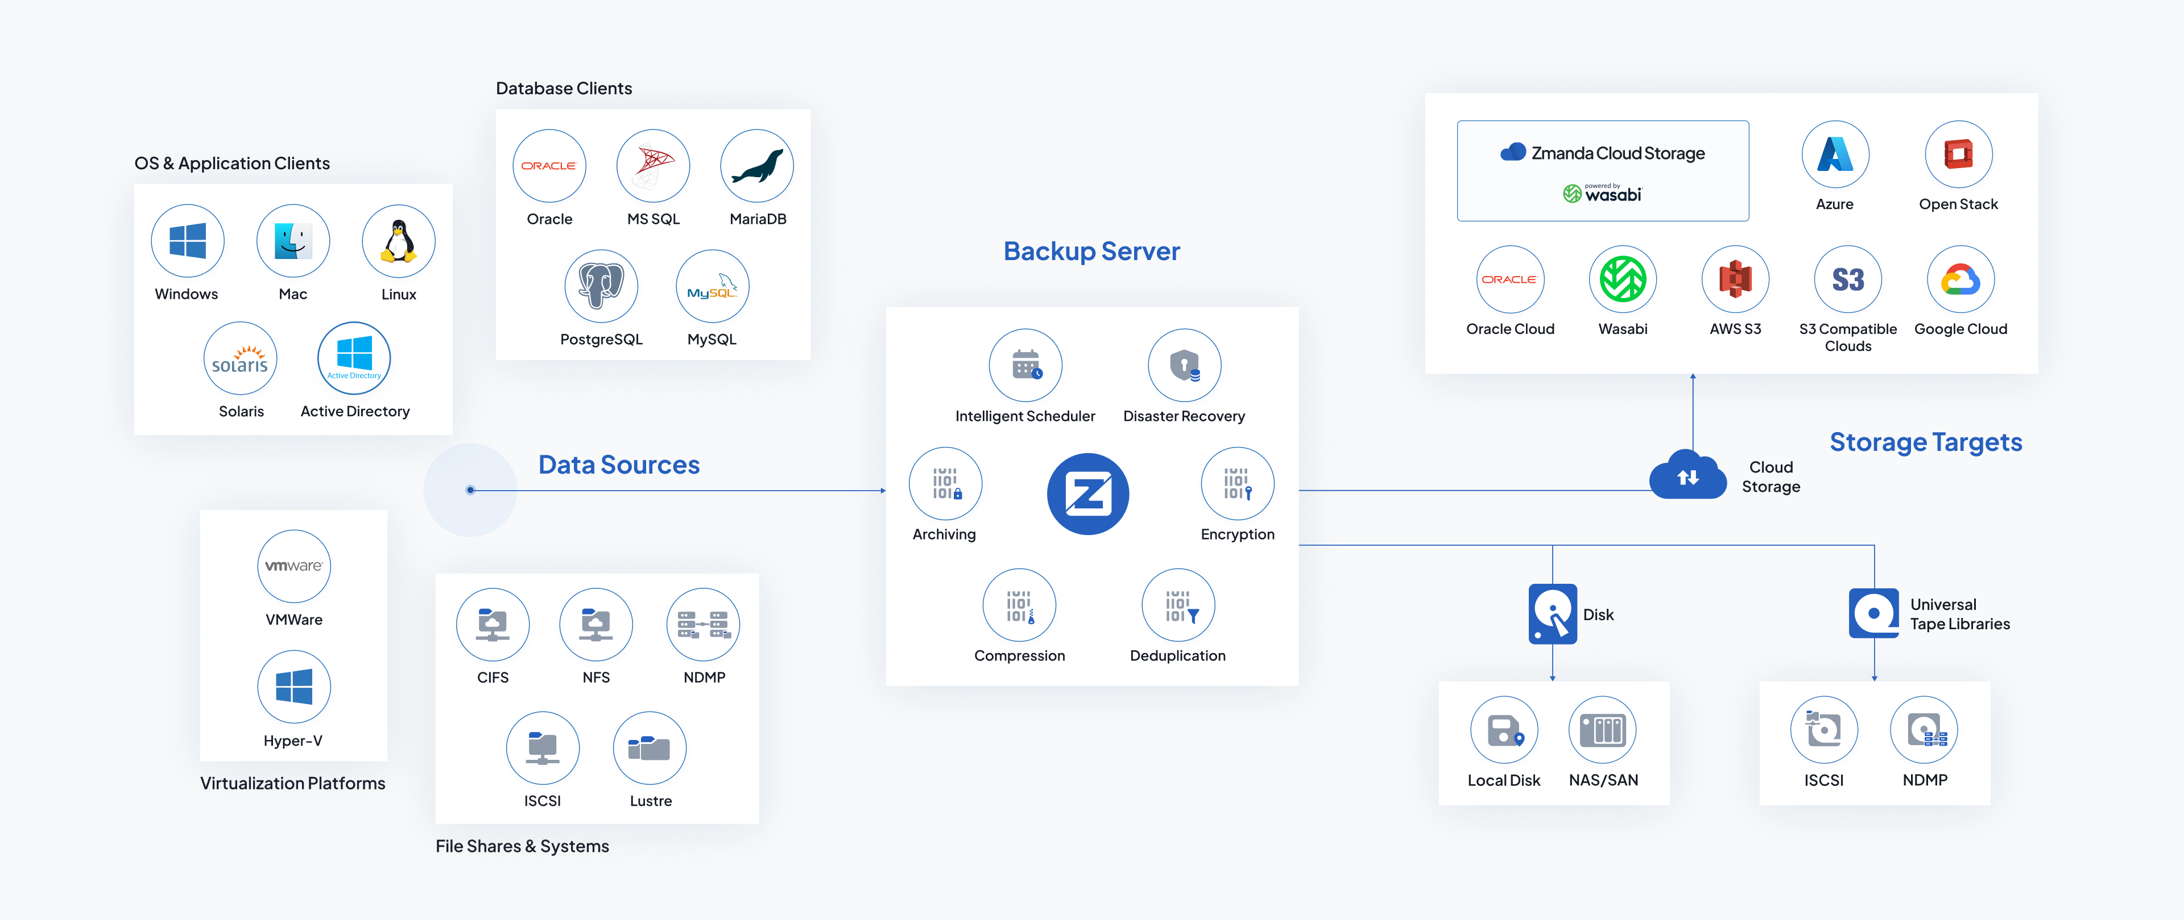
Zmanda capability diagram
ARCHITECTURE

Slide 10
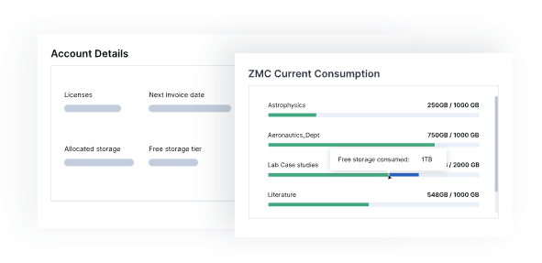
Zmanda Managed Storage
PRE-CONFIGURED CLOUD STORAGE
Benefits
Add offsite storage with 2 clicks of a button, allowing you to achieve 3-2-1 backup in 15 minutes or less.
Protect against ransomware with built-in detection and immutability.
80%+ TCO saving with simple, predictable, affordable pricing. Storage usage automatically optimized, compressed, and scaled.
Eliminate administrative overhead and instead focus on your core business. No need to worry about integration, APIs, provisioning, monitoring, maintenance, or optimization. Preconfigured and ready to go.
Zmanda is single point of support, billing, and reporting.
Details
$20 per TB per month (compare at $210+ with the competition)
1TB already included with Zmanda licenses
Powered by Wasabi with custom integrations to optimize utilization, security, and performance

Slide 11
Deploy in highly-controlled environments
CONTAINED DEPLOYMENT
Contained deployment strategies for air-gapped deployment of Zmanda.
No internet connection required.
Zmanda is highly secure as is designed to work entirely contained in your network.
Ideal for companies maintaining strict levels of security, privacy, and compliance.

Slide 12
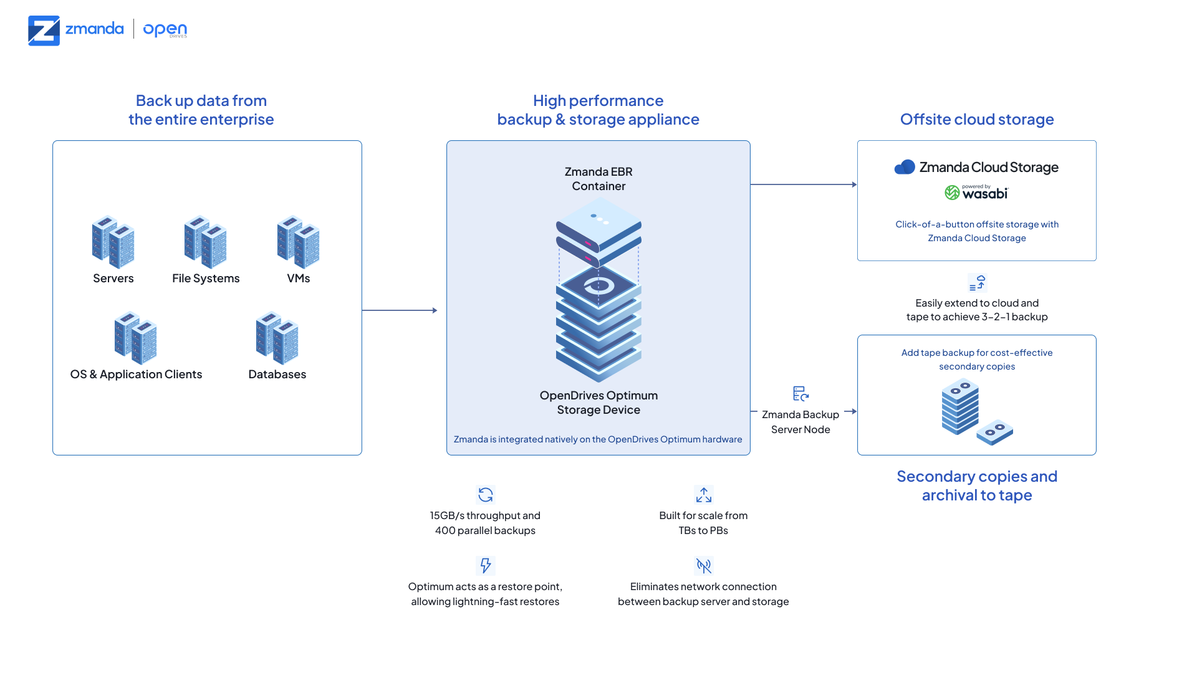
High-Performance 3-2-1 Backup Appliance
ZMANDA + OPENDRIVES

Slide 13
Thank You
For more information on Zmanda, please visit www.zmanda.com

